Slide 1

A Predictive Model for NBA Regular Season Franchise Success
Sydney Davis M.D , Lawton Walker Ph.D. , Nico Lindsay D.D.

Slide 2
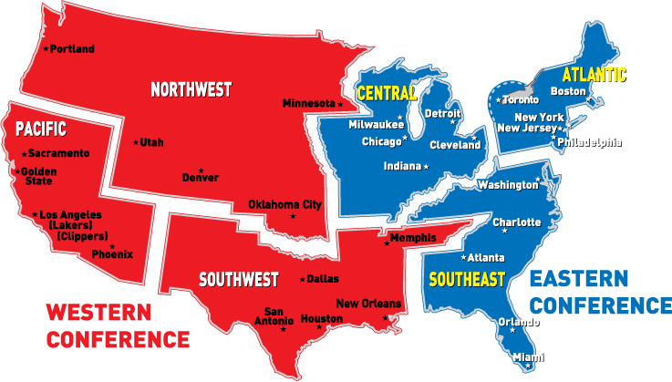
wHat iS thE nBA??
-30 teams
-82 games

Slide 3
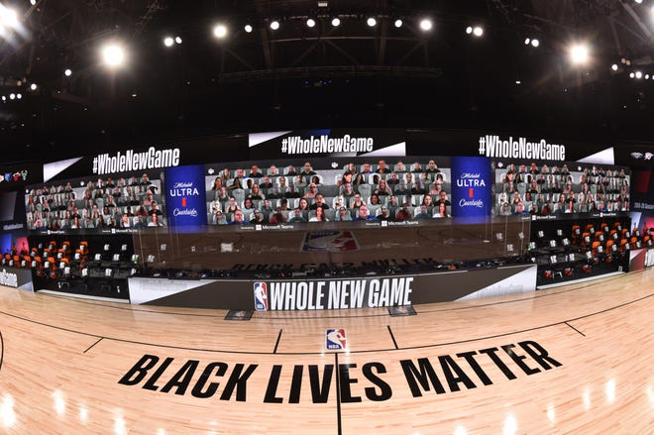
Why study the NBA?
Over $8 billion in revenue each season
Average of $292 million per franchise
Employs over 3,200 individuals
Pioneered the way professional sports responded to the COVID-19 pandemic
NBA “bubble” in Orlando, FL
Isolation zone for 22 teams and coaches as well as barbers, full time chefs, and doctors
Players tested for COVID-19 every 2-3 days
0 positive COVID cases

Slide 4

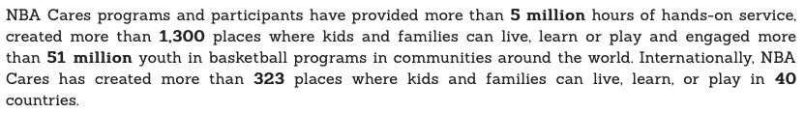
Why study the NBA? - continued
Vital community outreach programs at a global scale
NBA Cares programs support local youth and families
Youth basketball programs, community service, working with other programs to support education, youth and family development, and health-related causes
Partner programs include Special Olympics, YMCA, and Make-A-Wish Foundation
As of November 2020:

Slide 5
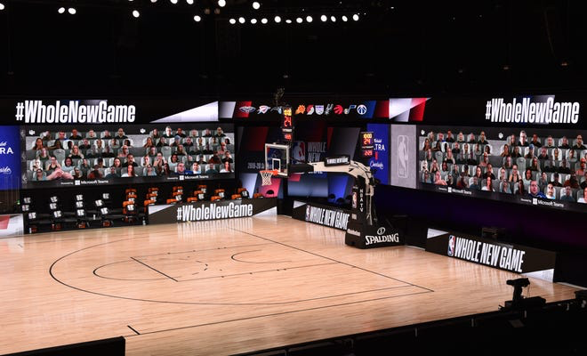
Potential Model Uses
Predictive model - decisions for the future
This type of Analysis is Vital to being a successful General Manager
Sports betting
Fantasy basketball teams
Baseline for Larger Models
Notes:
lol

Slide 6
Which Predictors?
Years since franchise inception (Q)
Historical win/loss % (Q)
Current coach’s number years with franchise (Q)
Current coach’s total years coaching (Q)
Current coach’s all-time win % (Q)
Coach of the year? (C,B)
MVP player in last 5 years? (C,B)
Playoff season appearances (Q)
Division titles won (Q)
Regular season conference wins (Q)
Championships won (Q)
Rookie of the year in last 10 years? (C,B)
Offensive rating (Q)
Defensive rating (Q)
Coach-player chemistry (Q)
Player-player chemistry (Q)
and more

Slide 7
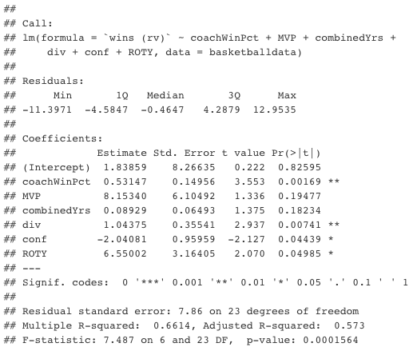
Initial Model
Models were built using stepwise regression
Notes:
Conference titles does not make sense with a negative coefficient.

Slide 8
Chosen Model: Predictors
Coach: The current head coach’s All-time win percentage………………..Q num *percentages were scaled up by 100
MVP: Is an MVP of the last five years on this team……………………………...CB num (0/1)
combinedYrs: Combined Player Experience measured in years……….Q num
div: Total number of division titles won in franchise history………….....Q num
ROTY: Is a Rookie of the year of the last 10 years on this team………..CB num (0/1)
Notes:
I added a lil asterisk saying that percentages were scaled up, we did it to make interpretations easier!! -syd

Slide 9
Chosen Model: Equation
Model Equation:
Wins = - 0.45543
+ 0.55470 * coachWinPct
+ 3.22367 * MVP
+ 0.10617 * combinedYrs
+ 0.50184 * div
+ 5.69019 * ROTY
Takeaway Statistics:
5 variables: 3 Q, 2 CB
Adjusted R² = 0.5104
F-statistic = 7.045
Overall p-value = 0.0003523
Residual Standard Error = 8.417
AIC = 220.26

Slide 10
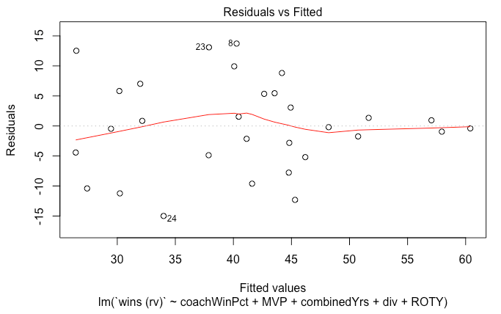
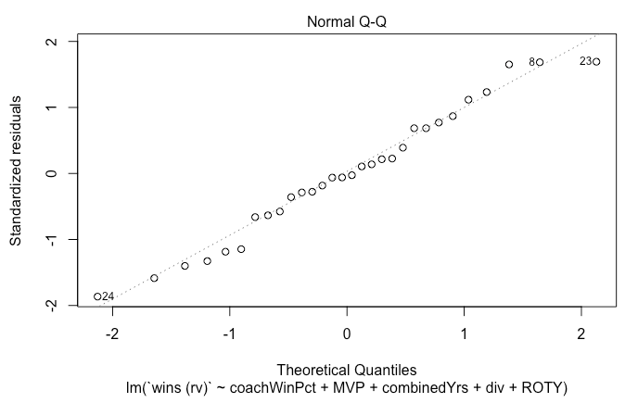
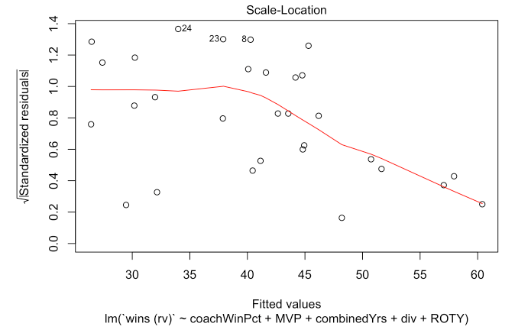
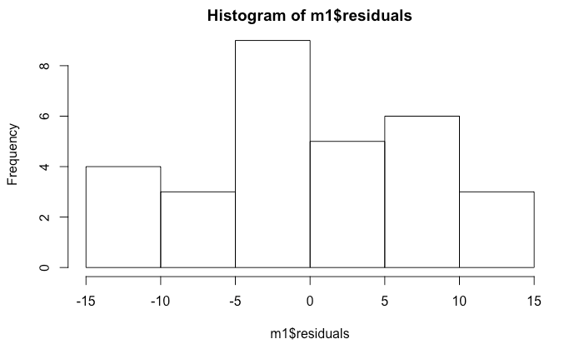
Assessing Conditions
Notes:
LINE !! Linearity, independence of residuals, normality of residuals, equal variance of residuals

Slide 11
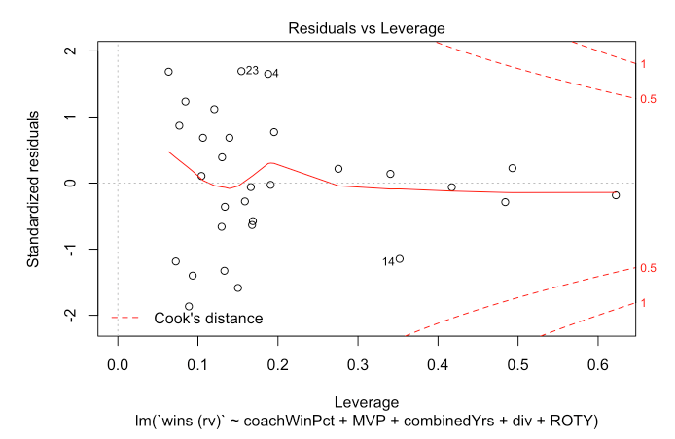
Why not remove outliers?
Because we want to be able to confidently use the model to predict the number of regular season wins for all NBA teams, not just the ones whose data would fit this model best.
What about Confidence and Prediction Intervals?
--Not estimating a mean or proportion
--Number of wins is a set value

Slide 12

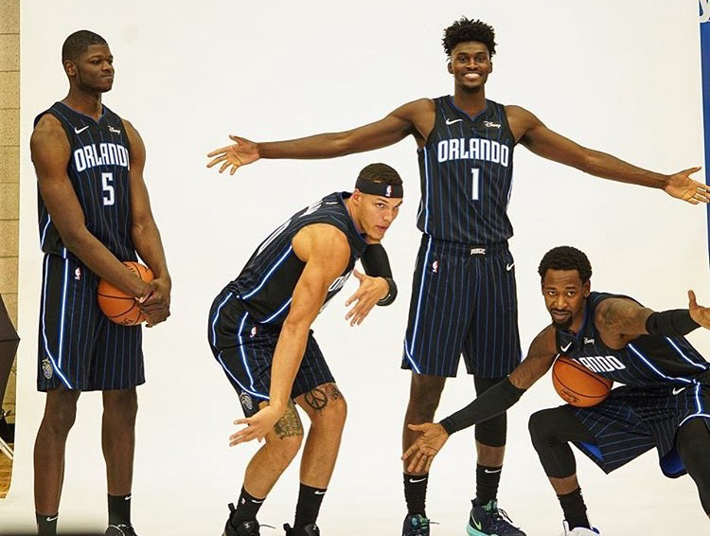
Applying the model: The 2019 Orlando Magic
Model Equation:
Wins = - 0.45543
+ 0.55470 * coachWinPct
+ 3.22367 * MVP
+ 0.10617 * combinedYrs
+ 0.50184 * div
+ 5.69019 * ROTY
Wins = - 0.45543
+ 0.55470 * (48) = 26.63
+ 3.22367 * (0) = 0
+ 0.10617 * (70) = 7.43
+ 0.50184 * (11) = 5.52
+ 5.69019 * (1) = 5.69019
-------------
= 44.81
Actual: 42

Slide 13

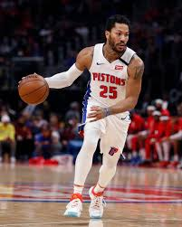
Applying the model: The 2019 Detroit Pistons
Model Equation:
Wins = - 0.45543
+ 0.55470 * coachWinPct
+ 3.22367 * MVP
+ 0.10617 * combinedYrs
+ 0.50184 * div
+ 5.69019 * ROTY
Wins = - 0.45543
+ 0.55470 * (52.4) = 29.07
+ 3.22367 * (0) = 0
+ 0.10617 * (60) = 6.37
+ 0.50184 * (11) = 5.52
+ 5.69019 * (1) = 5.69
+ -------------
= 46.65
Actual: 41

Slide 14


Applying the model: The 2019 Golden State Warriors
Model Equation:
Wins = - 0.45543
+ 0.55470 * coachWinPct
+ 3.22367 * MVP
+ 0.10617 * combinedYrs
+ 0.50184 * div
+ 5.69019 * ROTY
Wins = - 0.45543
+ 0.55470 * (70.9) = 39.33
+ 3.22367 * (1) = 3.22
+ 0.10617 * (39) = 4.14
+ 0.50184 * (12) = 6.02
+ 5.69019 * (1) = 5.69
-------------
= 58.4
Actual: 57

Slide 15
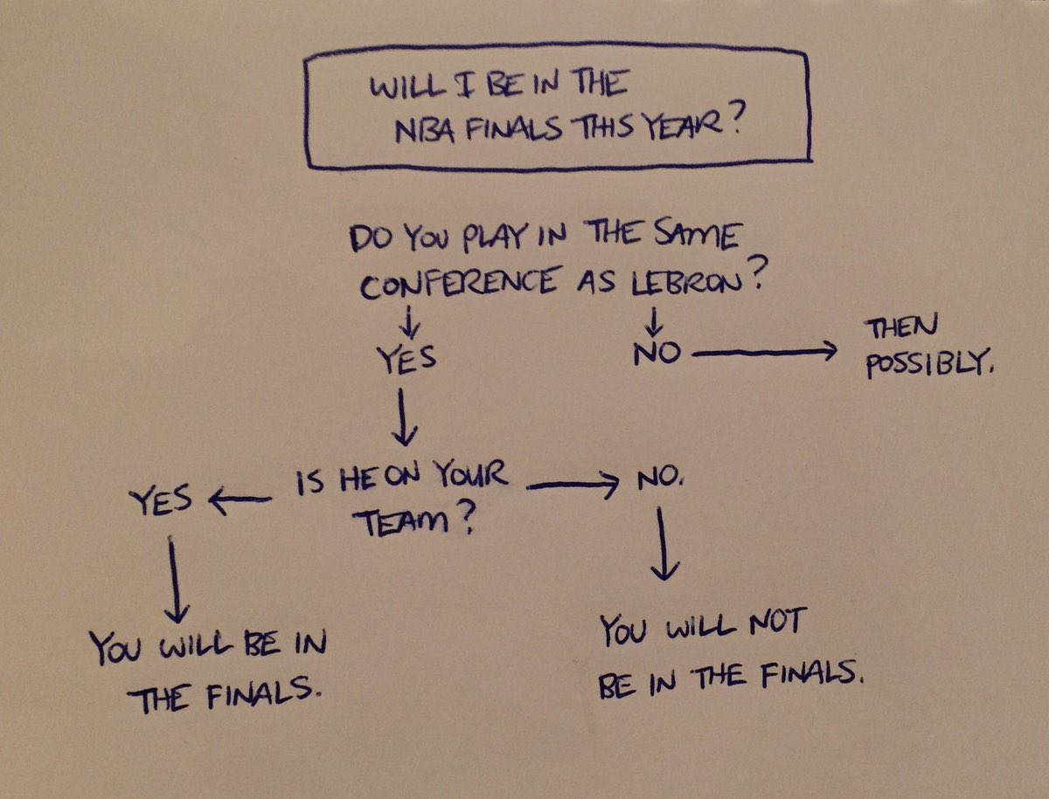

Slide 16
References
Annual revenue: https://www.statista.com/topics/967/national-basketball-association/
NBA Cares: https://careers.nba.com/community-involvement/ & https://cares.nba.com/mission/
Employee stats: https://www.owler.com/company/nba
Variables: https://www.basketball-reference.com

